Slide 1
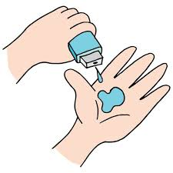
Doctors Visit
Prajan Kannan
APPLY ID = APPLY_172691061966ee909b1be68
Internship ID = INTERNSHIP_172663295366ea53f910591
Vellore Institute of Technology, Chennai Off Campus
Electronics and Computer Engineering

Slide 2

PROBLEM STATEMENT
Number of Duplicates found in the Dataset.
Find out Total number of People based on their count of illness.
Gender wise illness.
Analyse Maximum, Minimum and Medium income People.
Find the number of days of reduced activity of Male and Female separately due to illness.
Visualize, is there any missing values in the dataset using Heat map chart.
Correlation between variables (means columns) of the dataset and identify which variables are mostly correlated.
Analyse how income of People affects the number of visits to the Hospital.
Count and Visualize the number of Males and Females affected by illness.
Visualize the Percentage of People getting Govt. health insurance due to low income, due to old age. Also calculate the Percentage of People having Private Health Insurance.
Plot bar chart to analyse the reduced days of activity due to illness based on Gender.
Relation between Health status and Activity reduction using heat map chart.

Slide 3
Project Description This project involves an analysis of doctor visit data to understand health patterns and socioeconomic influences on healthcare access and well-being. The dataset comprises 5,190 observations with 12 variables, including the number of doctor visits, gender, age, income, recent illness and activity reduction due to illness, health scores, and insurance details. By exploring demographic factors, income levels, and chronic conditions, the project aims to uncover patterns in healthcare usage and determine whether certain groups are more affected by illness, limited activity, or healthcare costs. Mental well-being is assessed through GHQ-12 items, a set of questionnaire scores based on Goldberg's method. These scores provide insights into individuals' mental health by examining attributes like concentration, stress levels, social utility, and happiness. Positive scores indicate beneficial aspects of mental health, while negative scores highlight challenges. Through various data visualizations—heat maps, bar charts, and correlation matrices—the project aims to illustrate connections among income, health, activity reduction, and mental well-being, providing a comprehensive overview of factors influencing doctor visits and overall health status.

Slide 4

WHO ARE THE END USERS?
Healthcare Providers & Practitioners: Enable doctors and medical staff to understand patient behavior, healthcare utilization, and social factors affecting doctor visits, allowing for more personalized, effective care.
Health Policy Makers & Public Health Officials: Government agencies and health economists can use insights to create policies that improve healthcare access, address care disparities, and allocate resources more efficiently.
Researchers & Academics: Epidemiologists, sociologists, and public health researchers can analyze the data to study disease prevalence and how social determinants like mental health and income impact healthcare usage.
Insurance Companies & Actuaries: Health insurers and actuaries can assess patient profiles to design coverage that better meets the needs of people with various socioeconomic backgrounds and health statuses.
Non-Governmental Organizations (NGOs) & Advocacy Groups: Health advocacy and community organizations can use the data to address health disparities, improve outreach, and advocate for equitable healthcare policies.
Employers & Workplace Health Managers: Corporate wellness programs and HR can leverage insights to develop health initiatives and benefits that support employee well-being and productivity.

Slide 5
Technology Used
Python – For data analysis and visualization.
Pandas – Data manipulation and handling of large datasets.
NumPy – Numerical operations and data processing.
Matplotlib – Basic data visualization (bar charts, line plots).
Seaborn – Enhanced data visualization (heatmaps, correlation matrices).
Jupyter Notebook – Interactive environment for coding and data exploration.
PowerPoint – For presentation and visualization sharing.
Excel – Data preprocessing or basic analysis.
Julius AI (for research purpose) – For generating visualizations or analysis through AI tools.

Slide 6
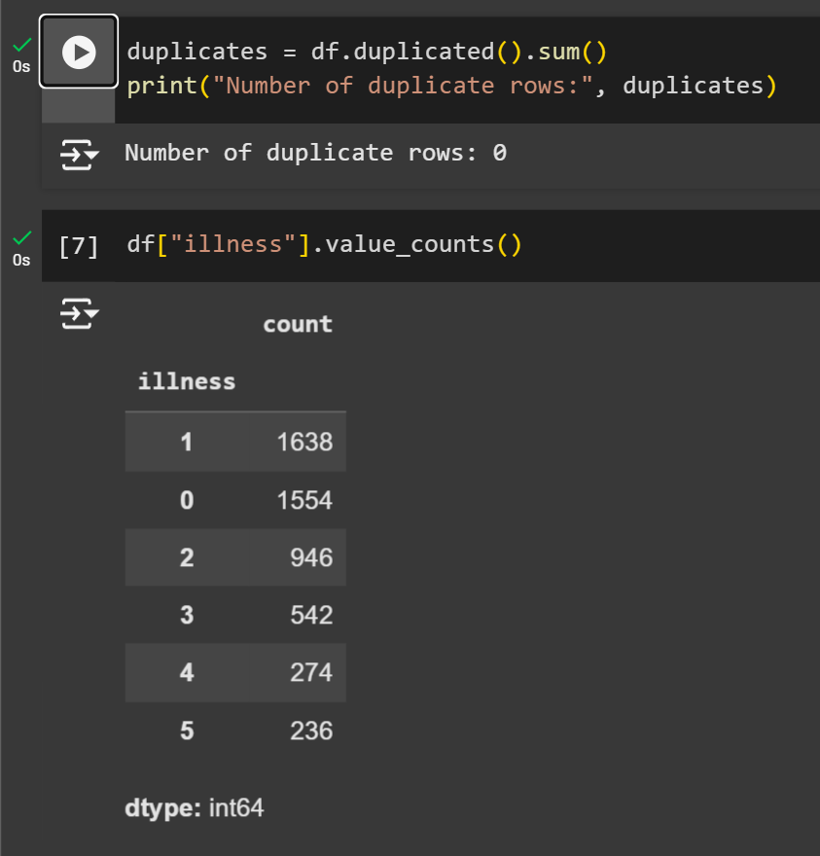
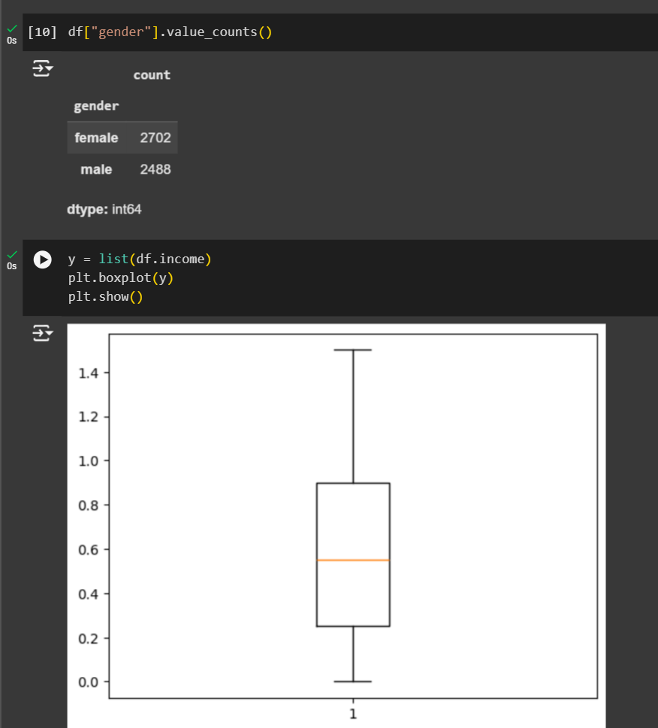
RESULTS
Here are the results :

Slide 7
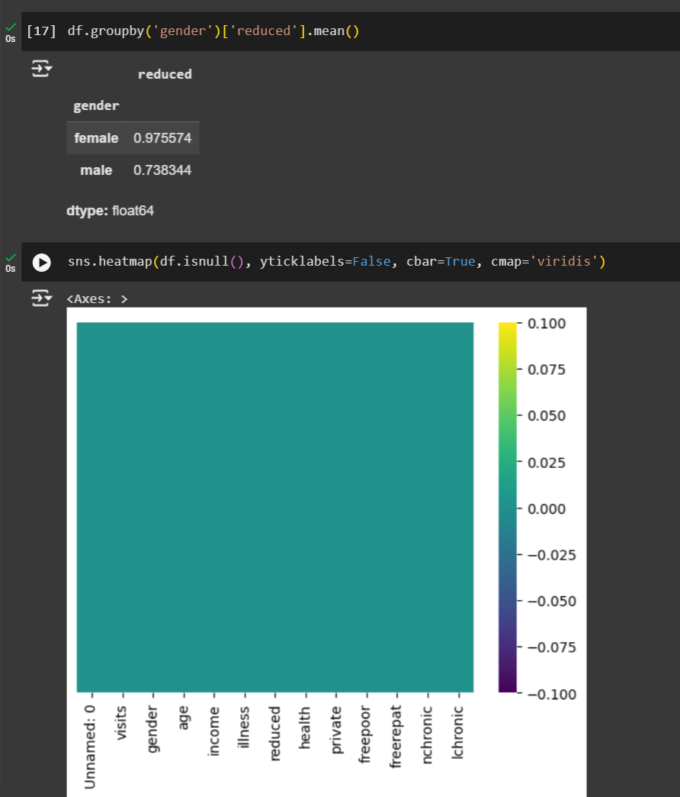
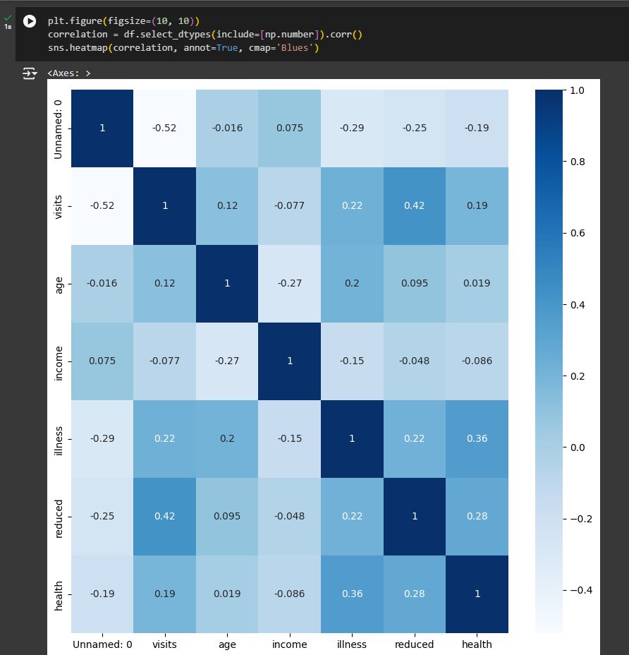

Slide 8
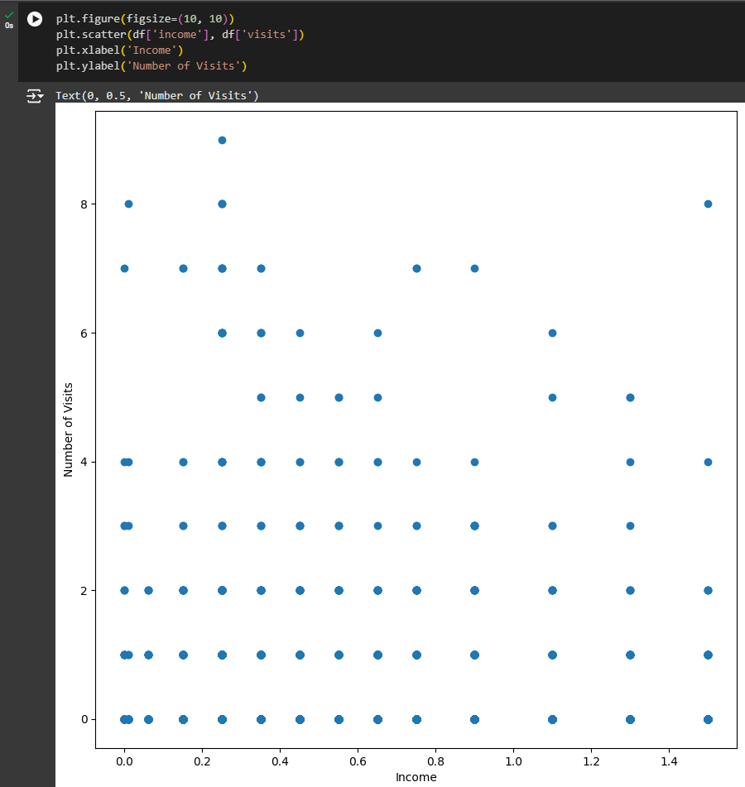
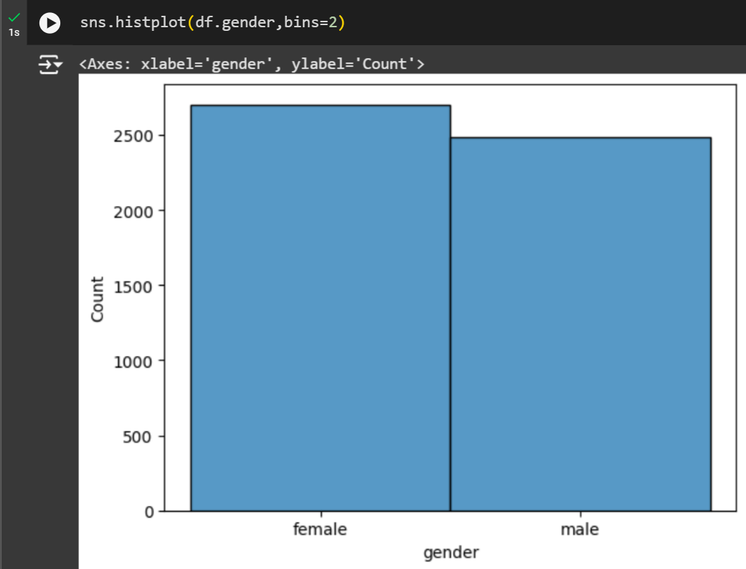

Slide 9
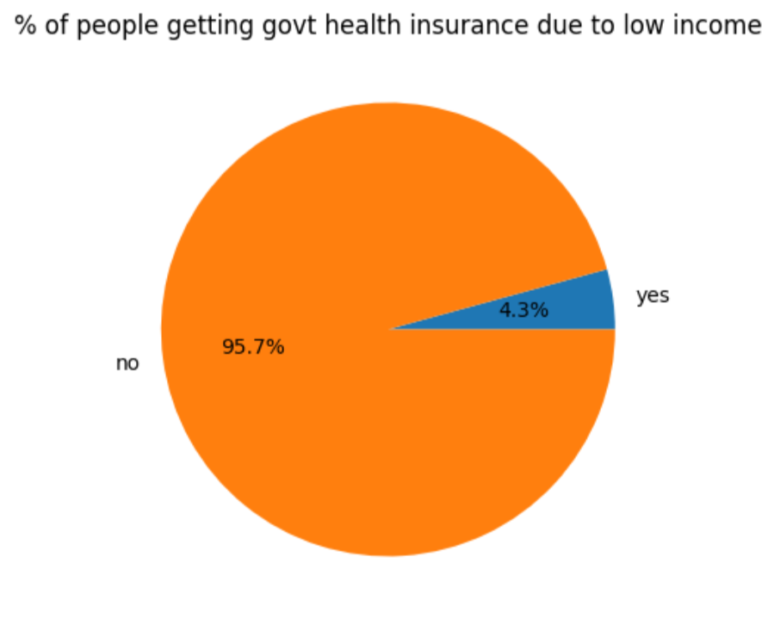
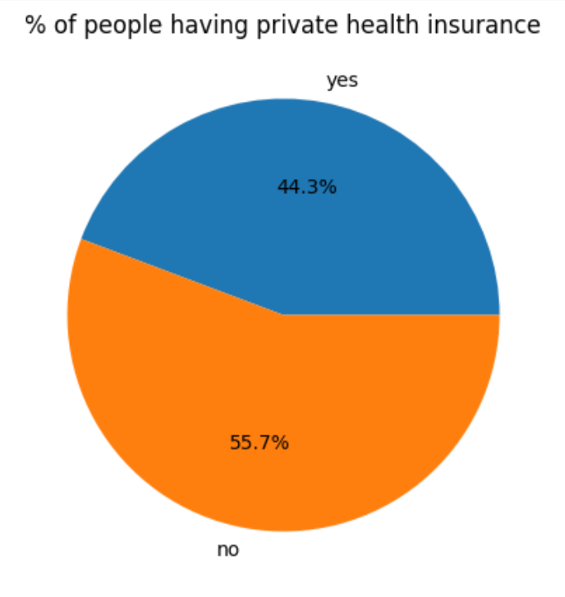
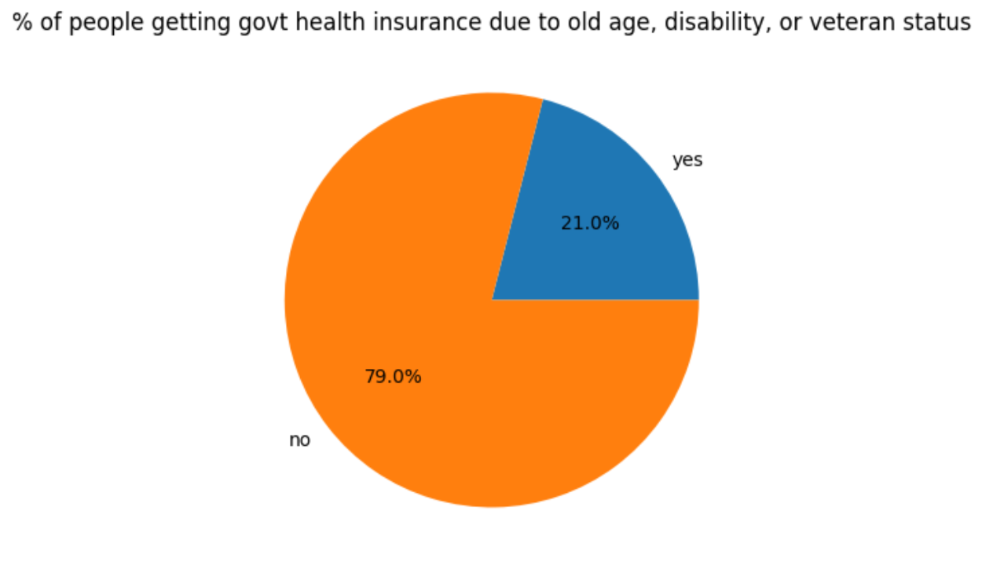

Slide 10
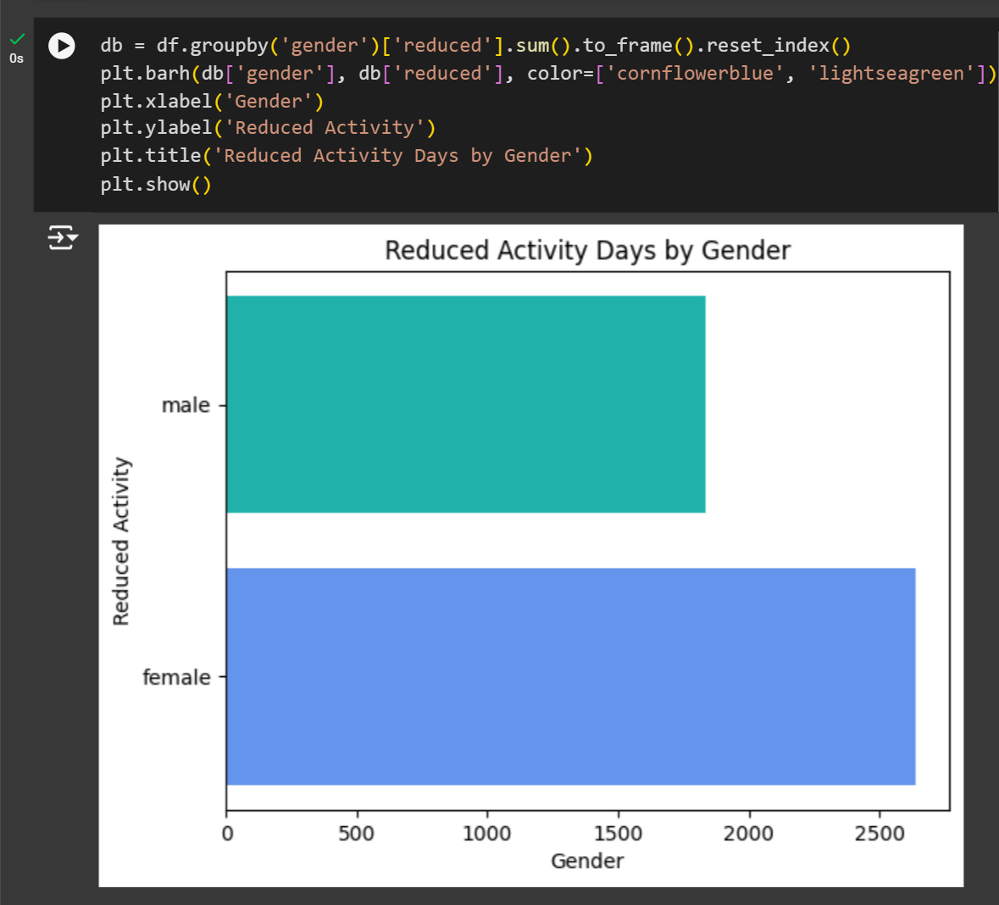
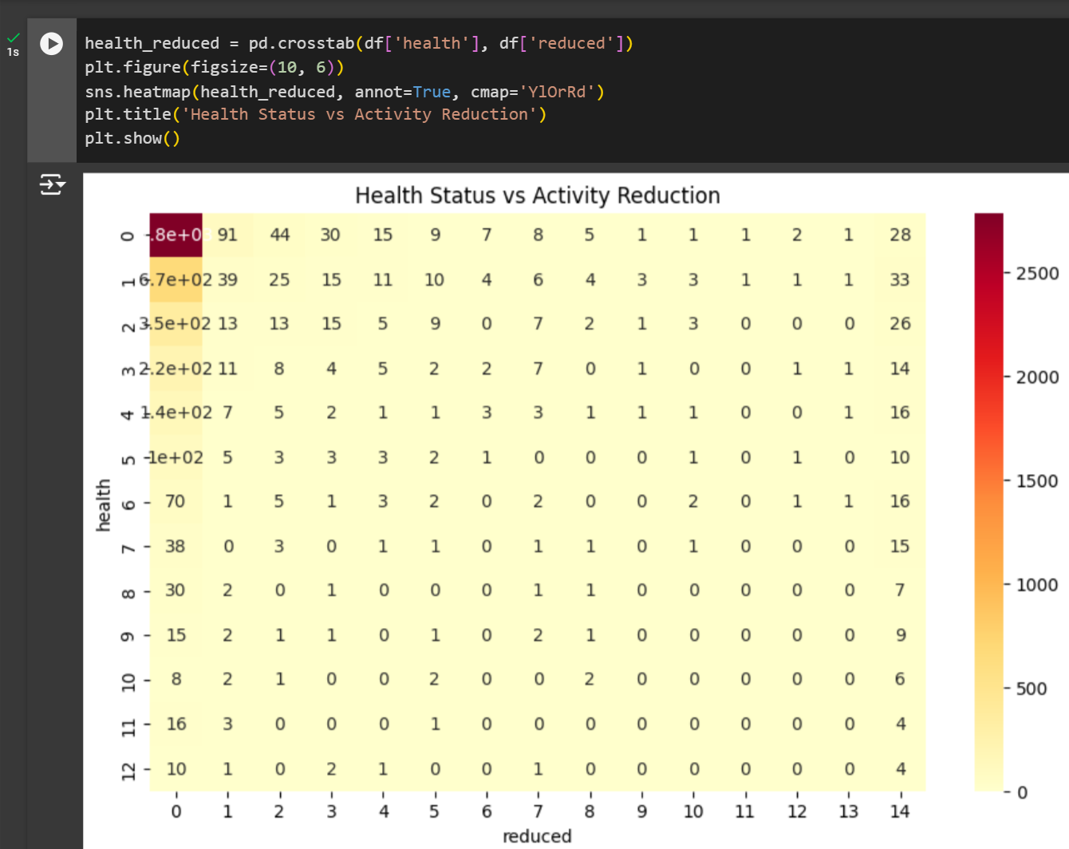

Slide 11
Thank you
Dear VOIS Team,
I would like to sincerely thank you for giving me the incredible opportunity to participate in the Data Analytics Virtual Internship. It has been an enriching experience, and I am grateful for the chance to work on such a meaningful major project. The knowledge and skills I gained throughout the program have been invaluable and I look forward to applying them in future endeavors.
Yours Sincerely,
Prajan Kannan

